Slide 1
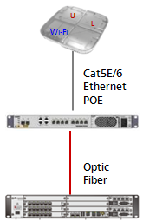
Huawei LampSite
Future-proof Indoor Solution
LampSite is a Huawei-developed leading in-depth coverage solution. This solution adopts BBU+RRU architecture, of which the base station consists of a baseband processing unit (BBU), pico remote radio unit (pRRU), and RRU HUB (RHUB). As a new platform to allow indoor solutions to evolve to LTE, LampSite is easy to deploy, supports smooth evolution, and allows high network performance and huge capacity. Therefore, it is ideal for large and medium indoor scenarios, like large office buildings, large venues, and transport hubs.
In indoor scenarios, radio signals are subject to building blocking and absorption during propagation, causing signal attenuation and coverage holes. Particularly in large buildings, radio channel congestion frequently occurs due to excessive mobile density. To address these issues, there is an increasingly strong demand on indoor coverage systems.
Platform for evolution of indoor networks
Along with large-scale transition from 3G to 4G, accelerated LTE application process, and increasing investment pressure on operators, indoor solution must be future oriented and support evolution to LTE-A, LTE-B, and even 5G.
LampSite uses BBU+RRU architecture, which makes it easy to achieve smooth evolution from various RATs.
LampSite is able to provide 2G, 3G, and 4G services and supports Wi-Fi and emerging LAA. Through software upgrade, LampSite can provide multiple LTE-A features, such as MU-MIMO, CoMP, and CA. With those features, LampSite significantly raises data rate toward users and spectral efficiency.
System architecture is unified between LampSite and Macros. Therefore, solutions and features can remain consistent between indoor and outdoor systems. Such strength means great convenience for operators to synchronize indoor and outdoor technologies.
High performance and huge capacity
LampSite allows multiple pRRUs to serve one cell, with a cell served by each individual pRRU having the same cell physical cell ID. In the uplink, LampSite adopts independent demodulation of signals from multiple pRRUs and then combines demodulated signals in the BBU without having an increase in background noise.
With these functions, LampSite remarkably improves downlink RSRP and SINR distribution and provides better uplink reception than DAS to ensure better network performance. With flexible, huge capacity feature, LampSite is able to absorb most of indoor service traffic. MU-MIMO and CA further position LampSite to provide high-rate service experience to users. With indoor dual-band CA, LampSite even provides a peak data rate of as high as 300 Mbit/s.
Smart O&M
LampSite supports pRRU-level network management, which allows users to get clear real-time information about statistics of handovers and call drops and device operating status of the indoor network. LampSite can share an NMS with macro networks so that indoor and outdoor networks adopt a unified network management system (NMS), which makes it possible to greatly lower operators' O&M costs.
LampSite supports SON features applicable to outdoor networks, which enables it to use self-planning and self-configuration to simplify network planning and optimization. Empowered with smart anti-interference and coordination algorithms, LampSite does well in addressing easy call drops in entrance/exit areas and outdoor signal intrusion in window areas.

Slide 2
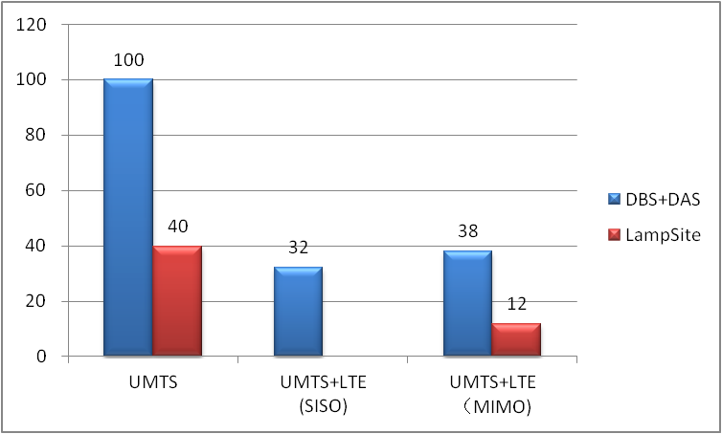
High Return on Investment (ROI)
Traditional DAS requires numerous RF feeders and special devices like combiners and splitters that must be installed by professional engineers. In this sense, DAS is born to be maligned with high costs and long construction time. Statistics show that DAS engineering cost accounts for over 70% of the total construction expenditure. In addition, reconstruction to support MIMO requires further investment to deploy another DAS system.
LampSite adopts optical fiber and Ethernet cables that do not require special engineers to complete installation, which can remarkably shorten deployment time and reduces engineering difficulties. Statistics show that LampSite can reduce construction period by 15 to 30 times. For example, the cable routing and device installation that may take one month to complete can be finished within a single day. Still more, LampSite does not require cabling adjustment to achieve system upgrade. Rather, an upgrade in LampSite can be done by adding new RF models to the pRRUs, as simply as changing light bulbs. Besides, LampSite simplifies engineering maintenance so that operators can make their investment count by focusing on device capacity expansion and system upgrade, which is essential to measurably increase their ROIs.
TCO per GB
UMTS Only: The per-GB cost of LampSite is just 40% of that of the current DAS.
UMTS+LTE with MIMO: The per-GB cost of LampSite is just 10% of the current DAS.

